Slide 1
Social Narratives of the CDD
Ali Dvorak, Katelyn Falk, and Rebecca Brummett
2012-2013 ILEND Trainees

Slide 2
Social Stories
Social Stories were created by Carol Gray and the Gray Center for Social Learning and Understanding.
Describe a social situation to children in a narrative form
Provide social cues and common responses for children with social skills difficulties
Improve a child’s understanding and expectations for a particular event
There is a very specific protocol for “Social Stories”.
We followed this protocol loosely, so we have called our stories “social narratives”
http://www.thegraycenter.org/social-stories

Slide 3
Using Social Narratives
The CDD is a clinical setting, which can cause anxiety in children, regardless of their diagnoses.
Parents can read these narratives to their children prior to their appointments or while they are in the waiting room.
Social Narratives can:
Reduce anxiety about appointments
Aid in transitions from the waiting room to exam rooms
Prime children for expected behaviors
Provide an outline of events to expect while at the CDD

Slide 4
CDD Social Narratives
General CDD
Weight Check
Playground
Medicine
Audiology
Physical Therapy
Occupational Therapy
Dentistry
Speech-Language Pathology
Psychology
Cognitive Testing
ADOS Testing
BBS
Education
Nutrition
Social Work

Slide 5
My Visit to the Audiologist
A Social Narrative

Slide 6
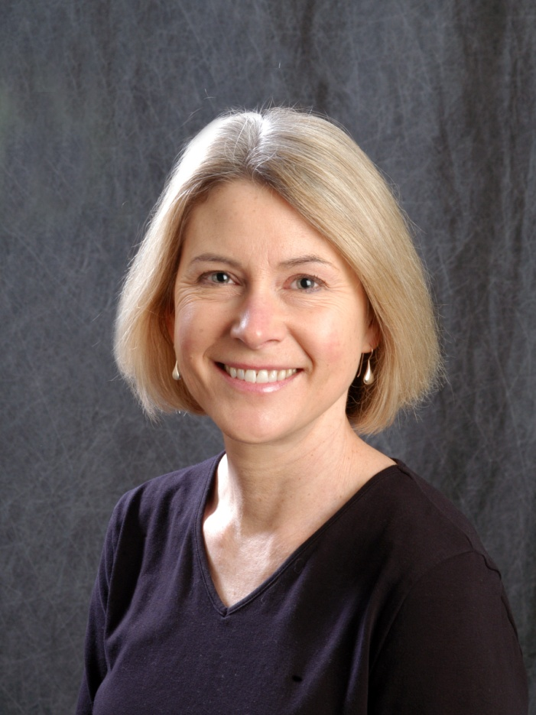
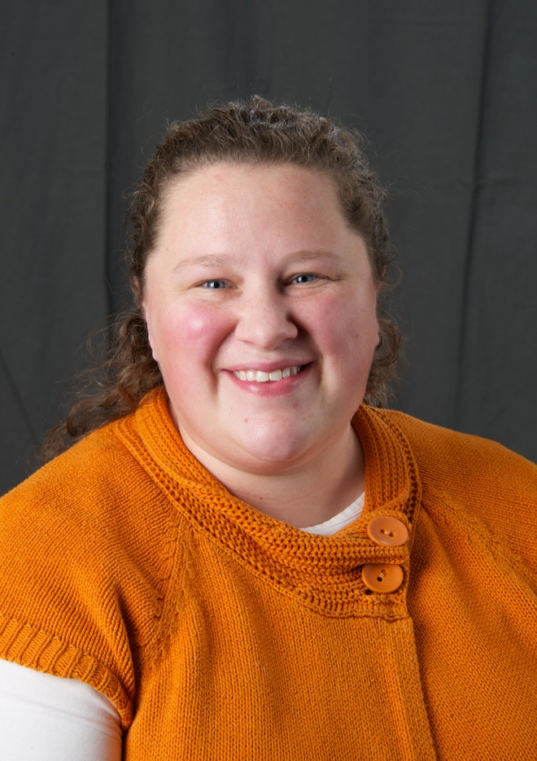
I am going to see the audiologist today. I might meet Ms. Lenore or Ms. Emily.

Slide 7
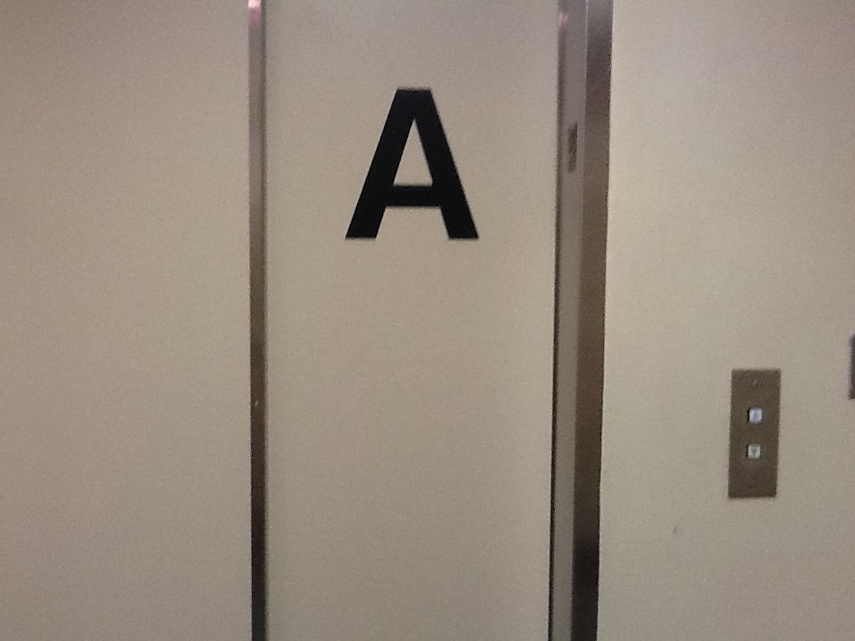
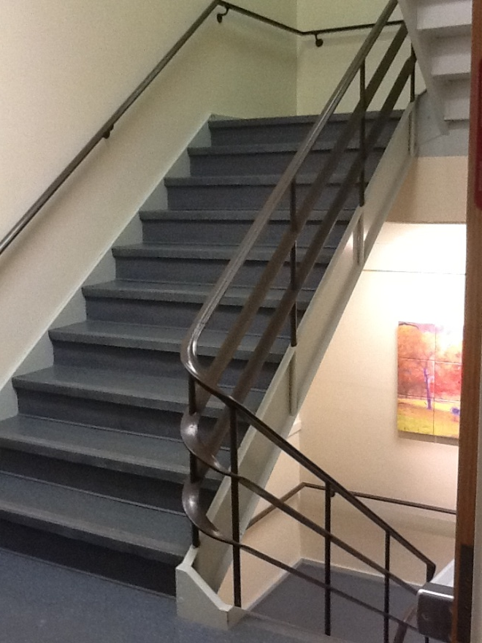
They will call my name and take me down to their booth on the first floor.
Elevator Stairs

Slide 8
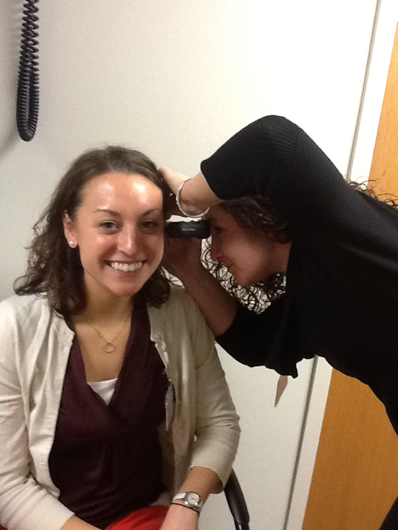
The Audiologist has a special room where they will look into my ears.

Slide 9
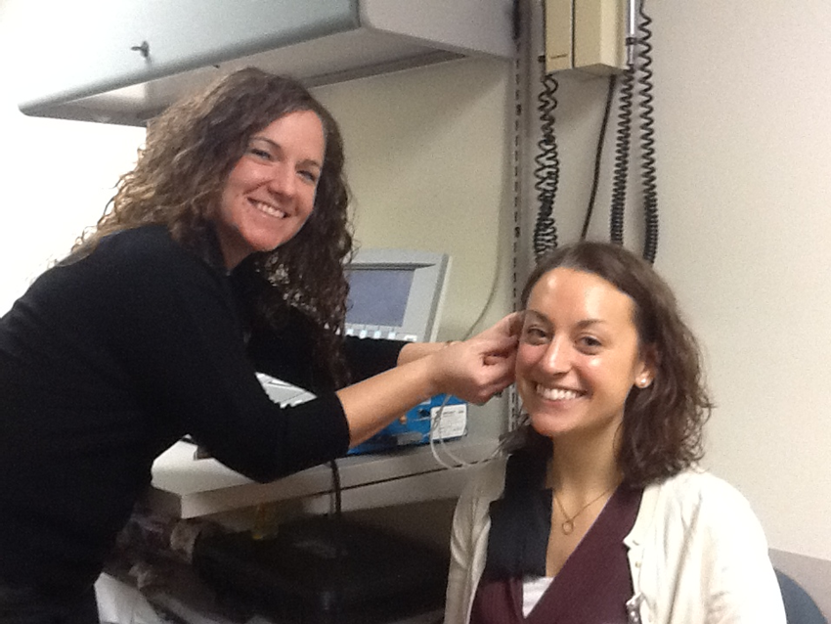
The Audiologist has a special tool to check if my ears are working.

Slide 10
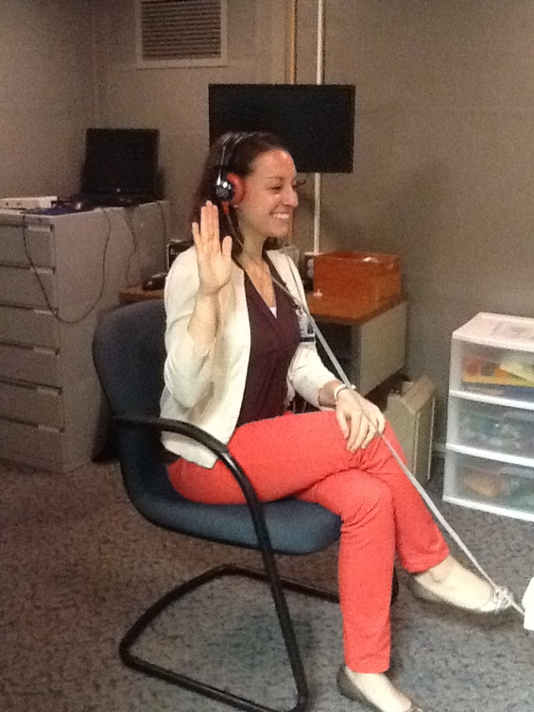
They will also give me really special headphones so I can hear a lot of different sounds. I will raise my hand when I hear the sounds. I might play a game with blocks too.

Slide 11
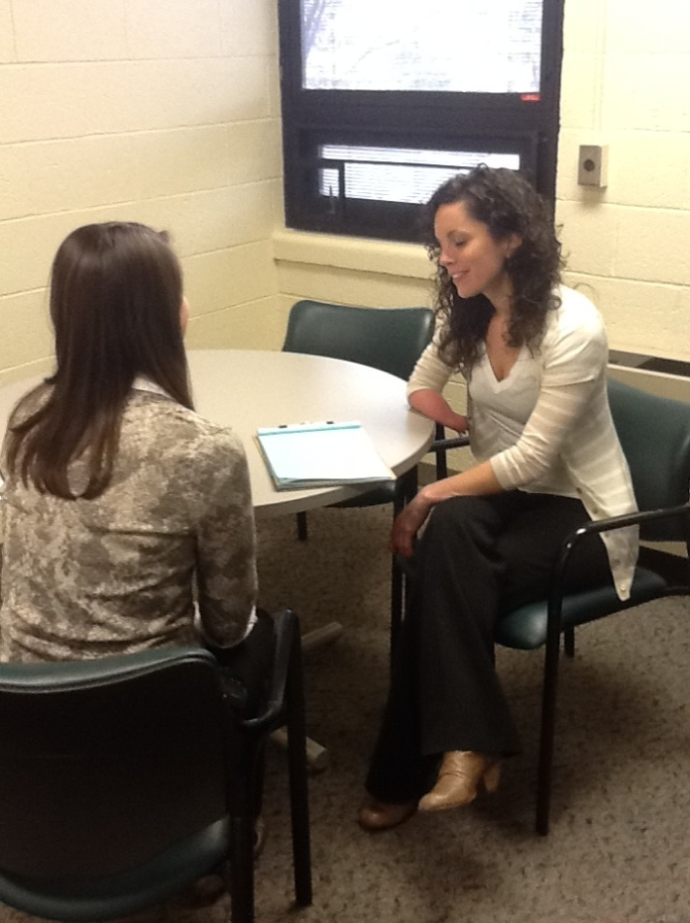
When I am done, the Audiologist might want to talk to my parents. I might sit quietly and read a book or play.

Slide 12
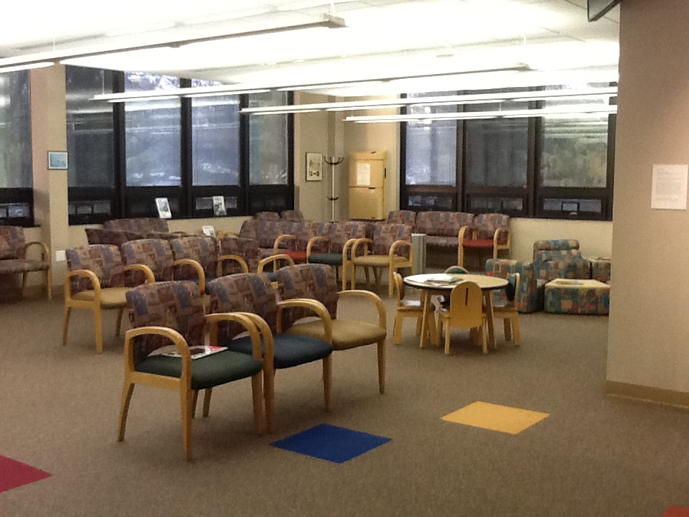
When I am all done, I will go back to the second floor waiting room to find out what I should do next.

Slide 13
Access to Social Narratives
Parents can obtain stories from:
Waiting room
CDD Website
Directions and Information about the stories will be available in the waiting room and online.

Slide 14
Thank you!
Thank you to all of you who answered our questions, emails, and pages throughout this project. Thank you for taking time out of your busy schedules to show us what you do!

Slide 15
Questions?

